Slide 1
Exploratory Data Analysis of Major Crimes in Toronto using R
Raviteja BoDla,
Metro College of technology

Slide 2
Objectives
Find the data regarding the major crimes in Toronto.
Clean the data.
Determine the major crime type.
Determine the months with high crime rate.
Determine the hour of the day with high crime rate.
Determine the neighbourhood with high crime rate.

Slide 3
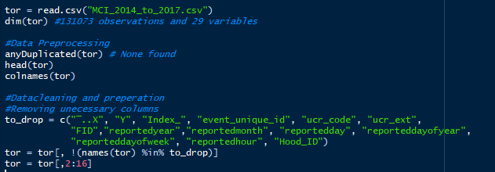
Data Cleaning

Slide 4
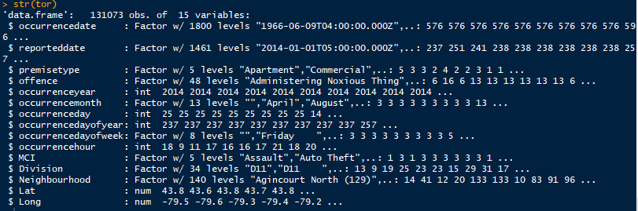

Slide 5
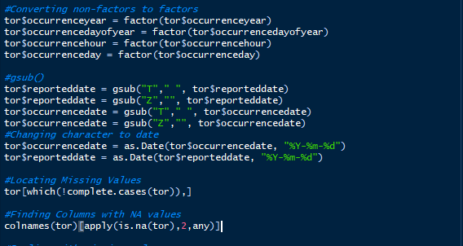

Slide 6
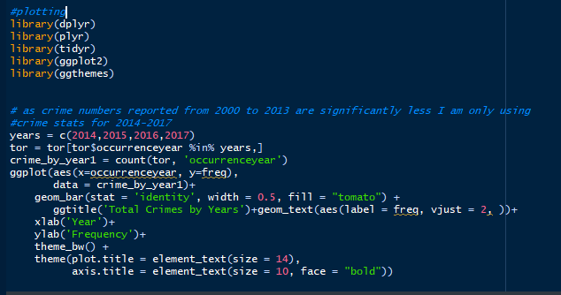

Slide 7
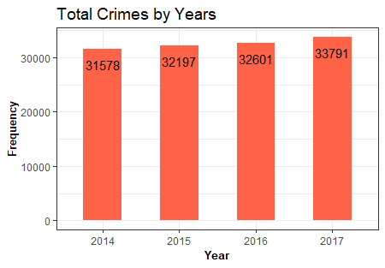

Slide 8
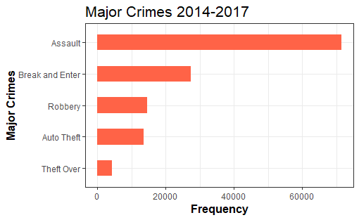
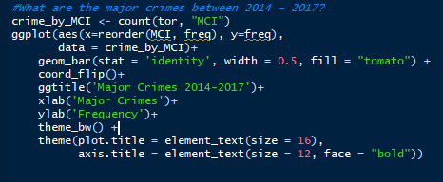

Slide 9
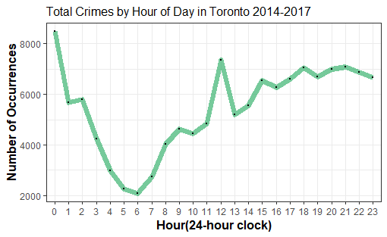
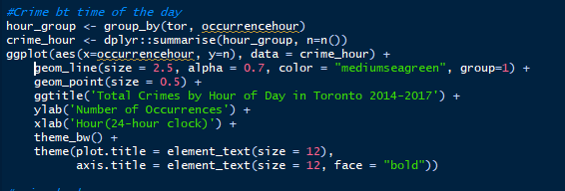

Slide 10
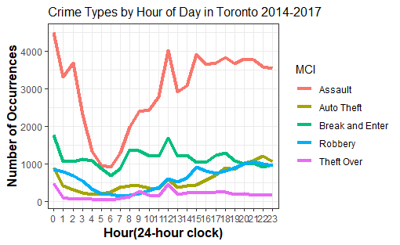
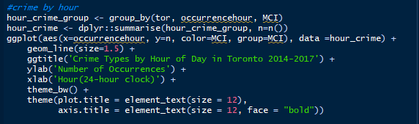

Slide 11
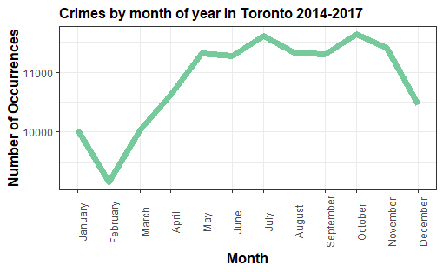
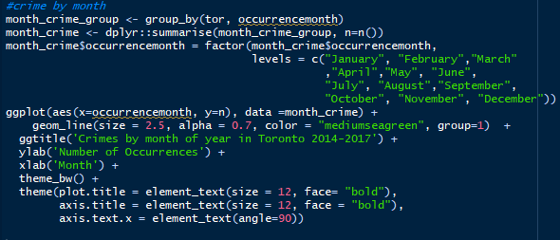

Slide 12
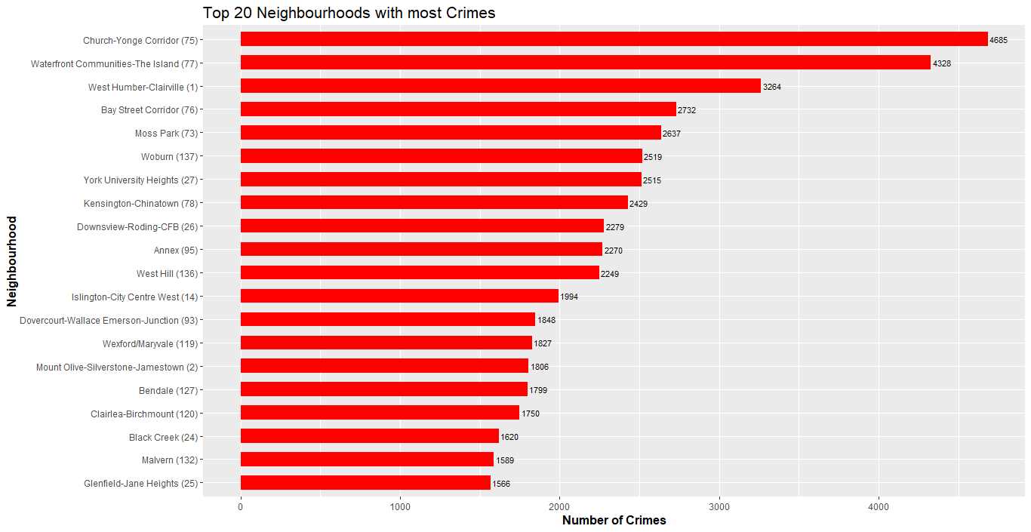

Slide 13
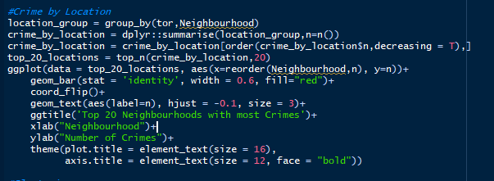

Slide 14
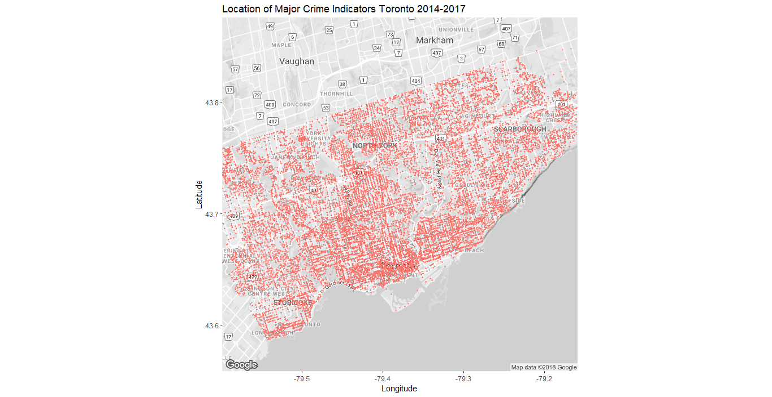

Slide 15
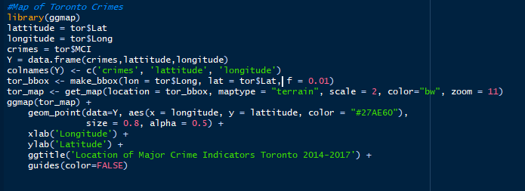

Slide 16
Conclusions
Crime rate increased from 2014-2017, but the rate of increase was not significant.
The major type of crime is assault with 70817 cases followed by auto-theft with 13435 cases.
Majority of crimes takes place during mid nights and early mornings. Break in and enter seems to also occur during afternoons (when people are at office).
May-November are the months with high crime rate and November-February are the months with low crime rates.
Church-yonge Corridor and Waterfront are the neighbourhoods with high crime rates.
Further study has to be done based on population density and crime rates to accurately determine the neighbourhoods with high crime rates.

